Slide 1
MOVE UP 2
STARTER UNIT
Lesson 3

Slide 3
MUSICAL CHAIRS
Notes:
REIVEW
Musical Chairs
Teacher clicks to icon to show the video.
Students prepare some school things in bags.
Play music and students move around the classroom.
Stop music and they must sit down at once and as fast as possible.
The student without seats will come to the front, take out one thing from his/her bag and say I have …. but I don’t have….
Continue this game as the same way.

Slide 5
Notes:
.

Slide 7
LESSON 3: SOUNDS AND LETTERS

Slide 8
A
a
ax

Slide 9
B
b
banana

Slide 10
C
c
cow

Slide 11
D
d
donkey

Slide 12
E
e
eagle

Slide 13
F
f
farm

Slide 14
LISTEN, POINT AND REPEAT

Slide 16
LET’S CHANT

Slide 17
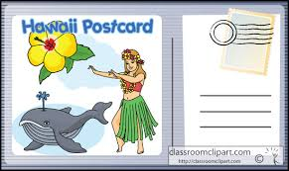
card
bus
dog
fish
Notes:
Show the flashcard of a bus.
Students have to write the beginning letter of “bus” on their mini board and show it to the teacher, then say letter b and sound /b/ aloud.
Do as the same way with other letters and sounds.

